Slide 1
DISCUSSION
Catão, L. A., & Milesi-Ferretti, G. M. (2014). External liabilities and crises. Journal of
International Economics, 94(1), 18-32.
Group 8:
Darin Biserta, Ivanna Rubio Leiva, Jan Smuts, Maja Neumayer, Zita Szekér

Slide 2
Motivation & Research Questions
Background
In theory, international borrowing allows countries to smooth consumption and finance investment, helping stabilize economies in the presence of shocks.
However, many financial crises have been preceded by large external imbalances and rising external liabilities.
While previous research has mainly focused on current account deficits or capital flows, less attention has been given to the levels and composition of external liabilities recorded in countries’ external balance sheets.
This raises an important question: does the accumulation of external liabilities increase a country’s vulnerability to external financial crises?
Research Questions
This paper examines whether large external liabilities increase the probability of external financial crises.
Identify thresholds beyond which additional accumulation of net external liabilities leads to a spike in external crisis risk.
Assess whether composition of external assets and liabilities influences crisis risk.
Formulate optimal models for predicting future external crises.

Slide 3
Data
Dataset
Panel of 70 countries (Inc. 41 emerging markets)
Period: 1970-2011
Key variables
Net foreign asset position (NFA/GDP)
Current account balance
External liabilities
Crisis prediction framework
Crises are defined as defaults, rescheduling events or events associated with loans twice the size of a country’s IMF quota.
While previous literature opted for broader definitions and in turn larger samples, stricter qualification ensures estimates are less biased by feedback effects as noted by Bussière & Fratzscher (2006) and events are more comparable.

Slide 4
Methodology
Econometric Specification
The paper evaluates whether external balance sheet indicators help predict external financial crises using panel probit models. The probability that country i experiences an external crisis in year t is estimated using:
Where:
Φ(⋅) = cumulative normal distribution (probit model)
NFL_{it-1} = net foreign liabilities (% of GDP)
CA_{it-1} = current account balance
RES_{it-1}= foreign exchange reserves
X_{it-1} = additional macroeconomic controls
The model estimates the probability that country i experiences an external crisis in year t.
Variables are lagged one year to capture predictive relationships and reduce simultaneity bias.
The focus is on how external liabilities and their composition affect crisis risk.
Empirical Implementation
Threshold analysis Identify levels of net foreign liabilities associated with higher crisis risk.
Probit crisis prediction models Estimate the marginal effect of external liabilities and macro variables on crisis probability.
Model evaluation using ROC curves Assess predictive accuracy by comparing true crisis predictions vs false alarms.

Slide 5
Main results - Threshold Identification
1. Large absolute external liabilities significantly increase crisis risk - Figure 3
Variables of 5 years before and after crisis episodes are studied.
Prior to crises, Net Foreign Liabilities (NFL) to GDP ratios are on average at about 50-60%.
Other variables show mixed behaviour, however years around crisis are associated with inflection points for indicators like current account balance and fiscal balance/GDP ratio.
The relationship remains robust across different model specifications.
2. Changes in relative levels are also associated with increased crisis risk - Figure 4
Treatment-effect regression is used to recover how changes in variables relative to country-specific and global mean.
Increase in NFL of 15-20% relative to mean values see increased crisis risk.
Reductions in CA and FX positions relative to mean precede crises. Other variables like relative fiscal deficit & global market volatility are also indicative.

Slide 6
Main results - Role of Balance Composition
Estimate the effects of explanatory variables and model performance by observing 1) marginal contributions to ROC scores, 2) elasticity estimates and 3) signal to noise ratios.
Bivariate model with lagged NFA/GDP scores better than multivariate specification used by Schularik & Taylor (2012).
CA/GDP ratio, REER gap and VIX improves ROC scores further.
Once properly controlled and low probability of crisis situations are excluded, better FX positions are found to mitigate crisis risks for given levels of NFA/GDP, while larger CA deficits contribute to increased crisis probability.
Negative sign for FDI liabilities is explained by strong economic performances attracting larger inflows.
Elasticity estimates of standard deviation changes support findings of treatment-effect regression - changes in net external debt and current account add to crisis risks, while FX accumulation decreases it.
A cut-off of around 50%, lag NFL/GDP is found to maximize the signal-to-noise ratio of the prediction model, supporting prior threshold estimates.

Slide 7
Main results - Model Prediction & Robustness
Adding current account gap and government debt to GDP have little effect on the model as a whole as they share high collinearity with other variables already included.
Results are robust to different crisis definitions - broader definition yields similar significances.
Stricter definition (as per Gourinchas & Obstfeld (2012)) makes FDI and CA less significant, while debts & reserves are more important (as found in past literature), as broader definition encompasses more developing countries who are sensitive to debt increases and reserve drainages.
Within-sample performance of conservative prediction (20% probability of crisis) has better classification score, however lower threshold of 11% leads to less false alarms.
Parsimonious model yields better results than Frankel & Rose (1996) and Berg & Pattillo (1996) and is balanced across regions.
Out-of-sample prediction with conservative threshold misses crises in Ecuador, Hungary and Ukraine, and gives false alarm for Lithuania.

Slide 8
Closing Remarks
Conclusion
Large external liabilities are an important predictor of external financial crises.
The relationship between external liabilities and crisis risk is non-linear, with sharp increases in vulnerability beyond certain levels.
The composition of liabilities matters:
debt liabilities increase crisis risk
equity and FDI liabilities are less destabilizing.
Monitoring countries’ external balance sheets is therefore crucial for assessing financial vulnerability.
Contribution
Provides new empirical evidence on the relationship between external balance sheets and external financial crises.
Moves beyond traditional indicators such as current account deficits, focusing instead on net foreign asset positions and liability composition.
Identifies threshold effects, showing that large external liabilities sharply increase crisis probability.
Demonstrates that external balance sheet indicators significantly improve crisis prediction models.

Slide 9
References
Berg, Andrew and Catherine Pattillo, 1999, “Are Currency Crises Predictable? A Test”, IMF
Staff Papers, 46, No. 2.
Bussière. Matthieu and Marcel Fratzscher, 2006, “Towards a New Early Warning System of
Financial Crises”, Journal of International Money and Finance, 25(6), pp. 953-973.
Catão, L. A., & Milesi-Ferretti, G. M. (2014). External liabilities and crises. Journal of
International Economics, 94(1), 18-32.
Gourinchas, Pierre-Olivier, and Maurice Obstfeld, 2012. "Stories of the Twentieth Century
for the Twenty-First." American Economic Journal: Macroeconomics, 4(1): 226-65.
Frankel, Jeffrey A., and Andrew K. Rose, 1996, “Currency Crashes in Emerging Markets:
An Empirical Treatment,” Journal of International Economics, 41, pp. 351–66.
Shularick, Moritz and Alan M. Taylor, 2012, “Credit Booms Gone Bust: Monetary Policy leverage Cycles, and Financial Crises, 1870-2008”, American Economic Review, 102(2), pp. 1029-61.

Slide 10
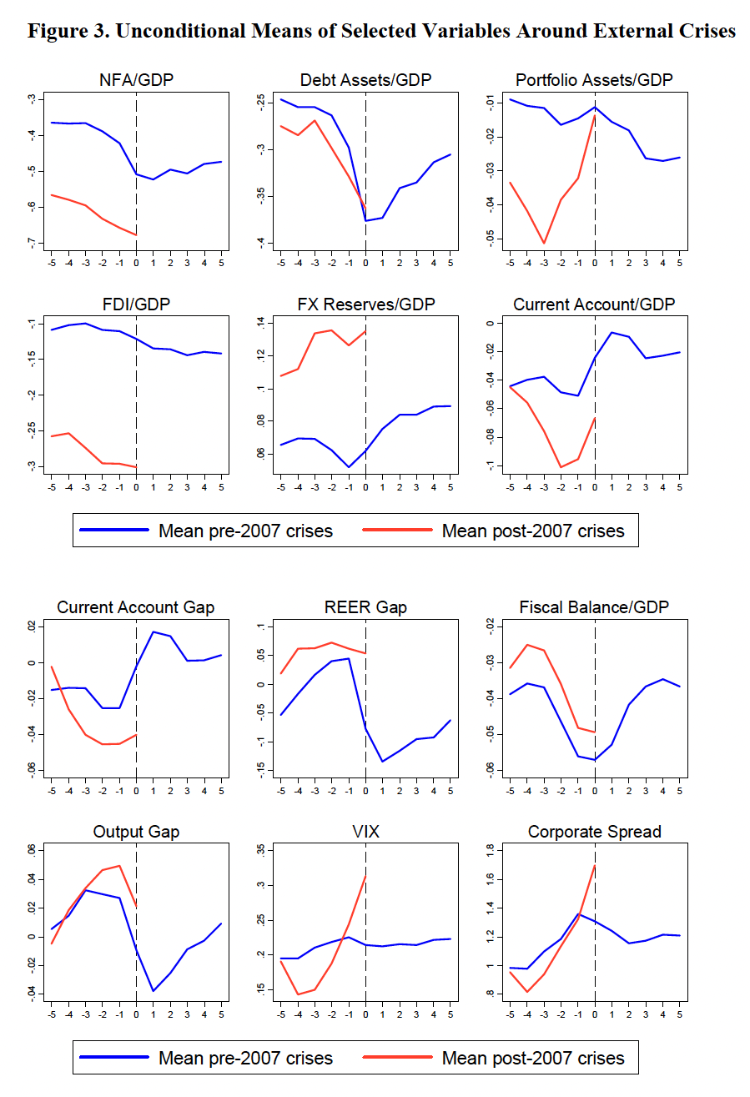
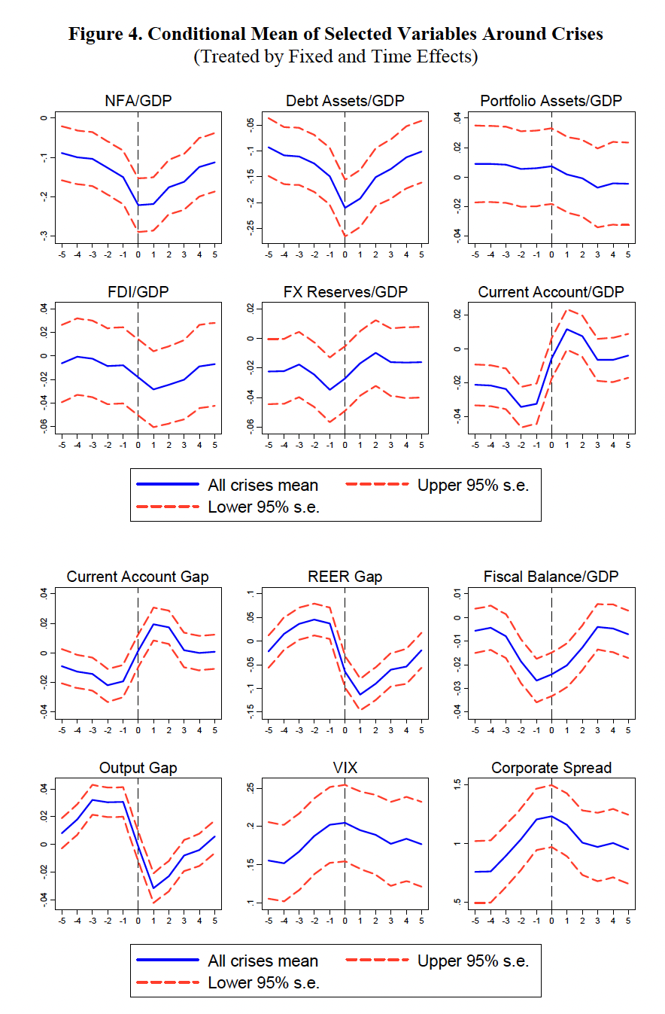
Appendix I

